Slide 1
Clean architecture.
How to structure your project.
Joanna Lamch
2020
Notes:
dziekuje ze tak licznie przybyliscie na moja prezentacje i mozliwosc podzielenia się z wami odrobina wiedzy jaka zebrałam …. Nie wiem co dodac
Chciałabym wam przybliżyć choć trochę temat web assembly –

Slide 2
Architecture

Slide 3
What is Software architecture?
the fundamental structures of a software system and the discipline of creating such structures and systems.
Each structure comprises software elements, relations among them, and properties of both elements and relations.
Notes:
The architecture of a software system is a metaphor, analogous to the architecture of a building.^{[2]} It functions as a blueprint for the system and the developing project, laying out the tasks necessary to be executed by the design teams.^{[3]}
Software architecture is about making fundamental structural choices that are costly to change once implemented. Software architecture choices include specific structural options from possibilities in the design of the software. For example, the systems that controlled the Space Shuttle launch vehicle had the requirement of being very fast and very reliable. Therefore, an appropriate real-time computing language would need to be chosen. Additionally, to satisfy the need for reliability the choice could be made to have multiple redundant and independently produced copies of the program, and to run these copies on independent hardware while cross-checking results.

Slide 4
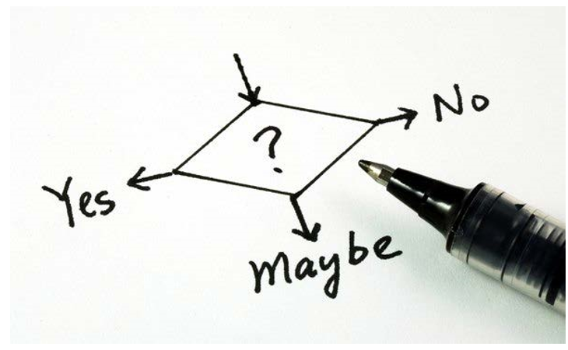
Decisions, Decisions, Decisions
Context is king
All decisions are a tradeoff
Align with business goals
Use your best judgement
Remember about the team

Slide 5
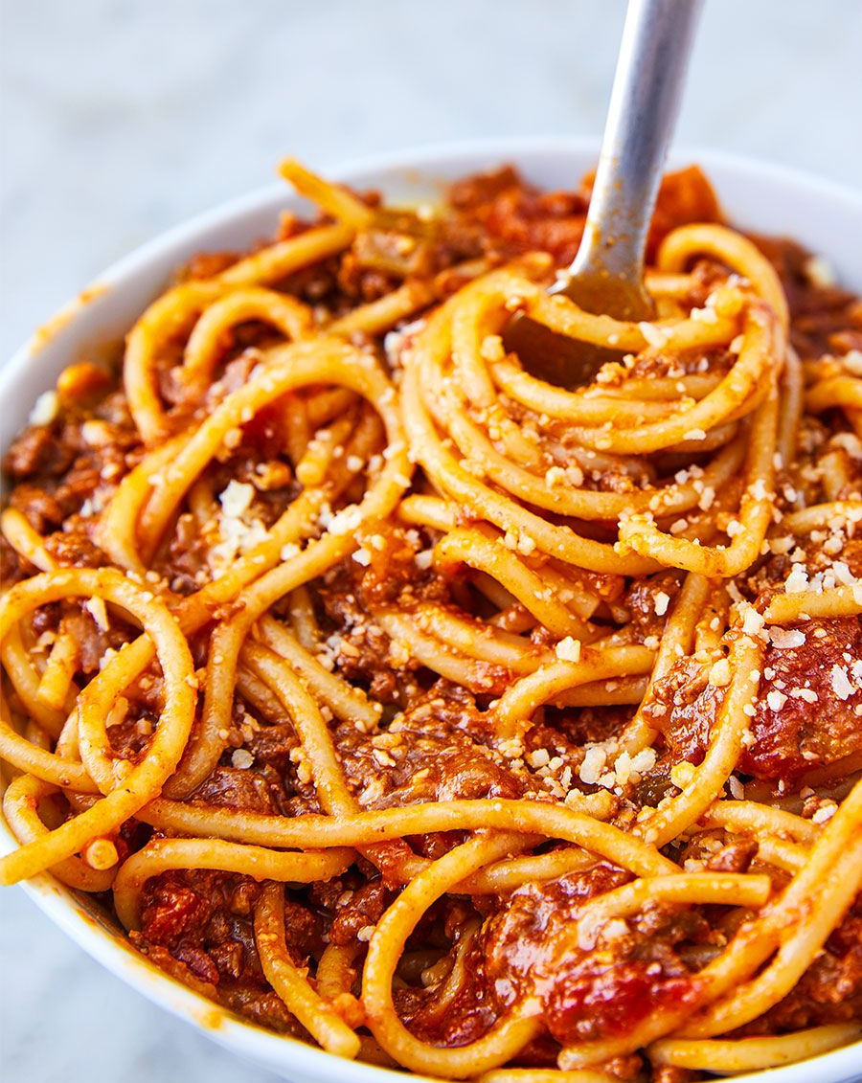
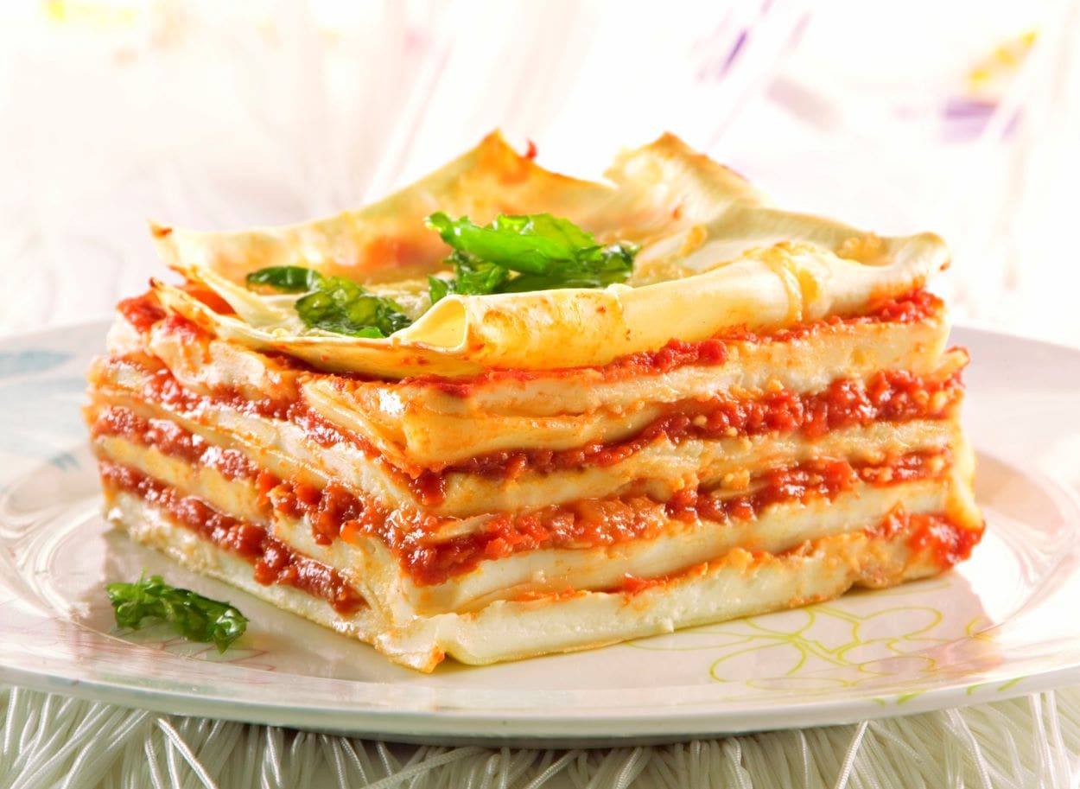
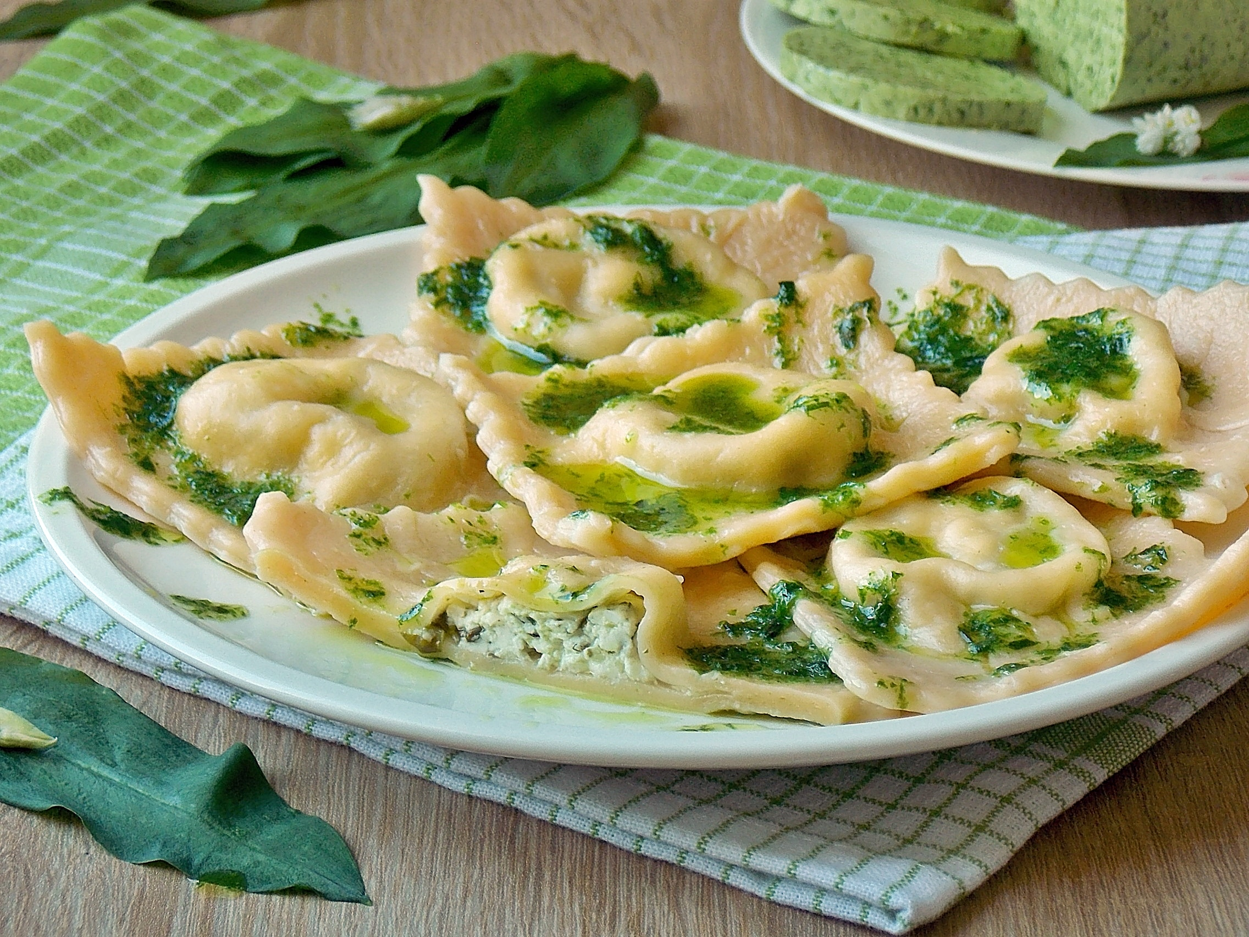
Architecture history
Spaghetti
A log of copy-paste
Whole application deployed/ delivered as one piece
Lasagne
3 layered architecture
DB, Business Logic, Frontend – different teams, with separated responsibilities
Whole application deployed/ delivered as one piece
Ravioli
Microservices
Should be atomic
Should implement whole functionality
Cross-functional teams
Each piece can be deployed independently
Notes:
Zespoly pizzowe – Jeff Bezos 5-7 osob w zespole – czyli 2 pizze

Slide 6
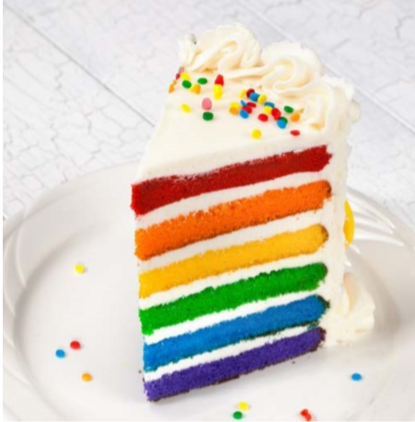
What are layers?
Level of abstraction
Single-responsibility
Isolate roles and skills
Multiple implementations
Varying rates of change
Notes:
Managable units of abstraction

Slide 7
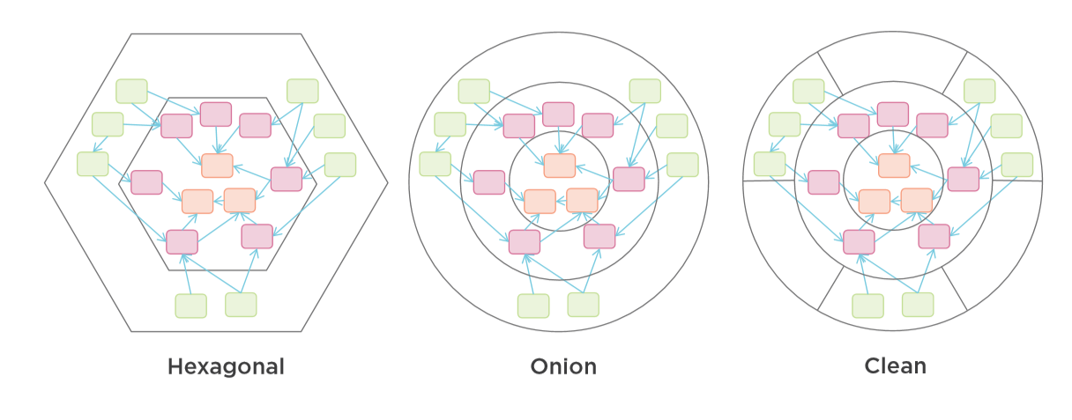
Common Architectures

Slide 8
Classic Three-layer Database-centric Architecture Onion Architecture
Three-layer Architecture
UI
Business Logic
Data Access
Database

Slide 9
Three-layer Architecture
Users
User Interface
Business Logic
Data Access
Database or other persistence source

Slide 10






Three-layer Architecture
Real life
Users
User Interface
Module
Module
Module
Business Logic
Module
Module
Module
Data Access
Module
Module
Module

Slide 11
Hexagon
Some API 1
Hexagon
API
Adapter
User Interface
Abstraction Layer
UI
Adapter
HTTP Server
Port
Some API 2
User Interface
Port
Other API
Adapter
Application Logic
Domain Model
DataBase
Port
Database
Other
Port
DataBase
Adapter
Other Adapter
Data Store
Port
Other Service
Azure Storage
Azure Storage
Adapter

Slide 12
Hexagon
Some API 1
Hexagon
API
Adapter
User Interface
Abstraction Layer
UI
Adapter
HTTP Server
Port
Some API 2
User Interface
Port
Other API
Adapter
Application Logic
Domain Model
Dependency Injection
DataBase
Port
Database
Other
Port
DataBase
Adapter
Other Adapter
Data Store
Port
Other Service
Azure Storage
Azure Storage
Adapter

Slide 13
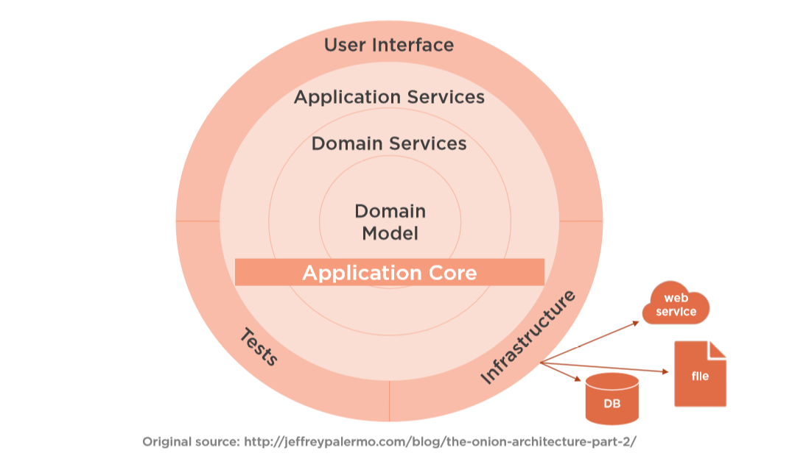



Clean Architecture
User Interface
User Interface
Application Services
Domain Services
Domain Model
Some API 1
Infrastructure
Tests
Azure Storage
Database

Slide 14
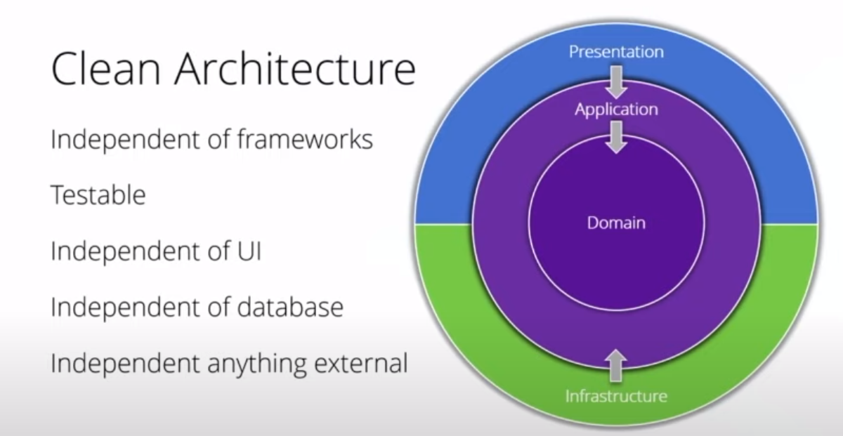
Clean Architecture

Slide 15
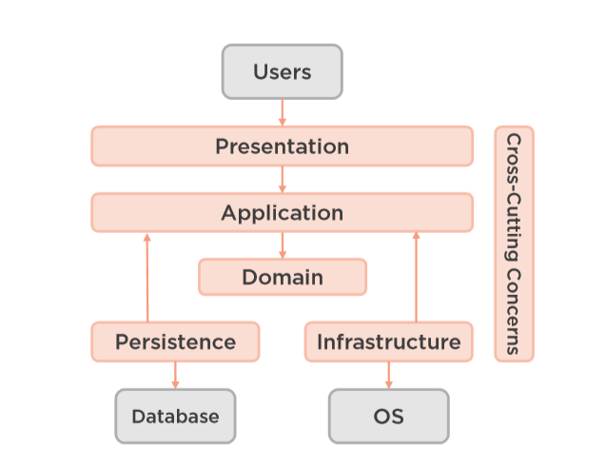
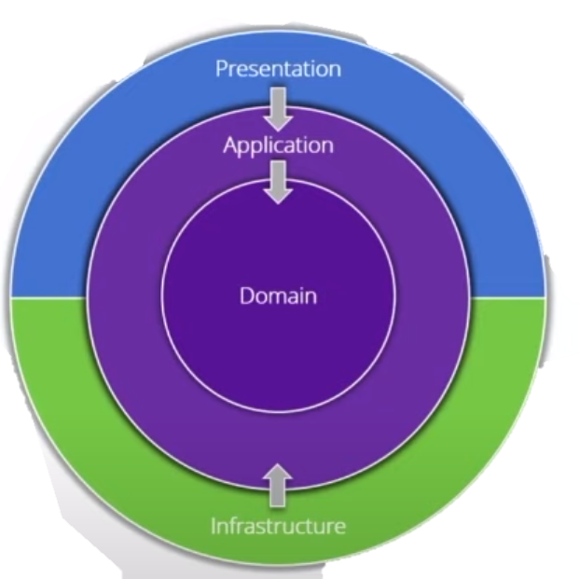
Modern Four-Layer Architecture

Slide 16
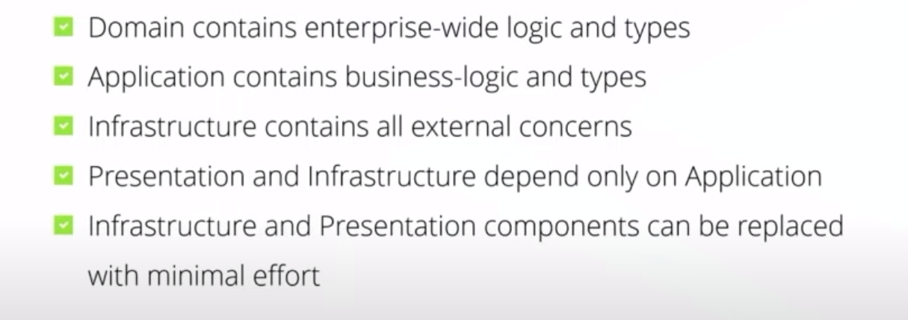
Key Points in Clean Architecture

Slide 17
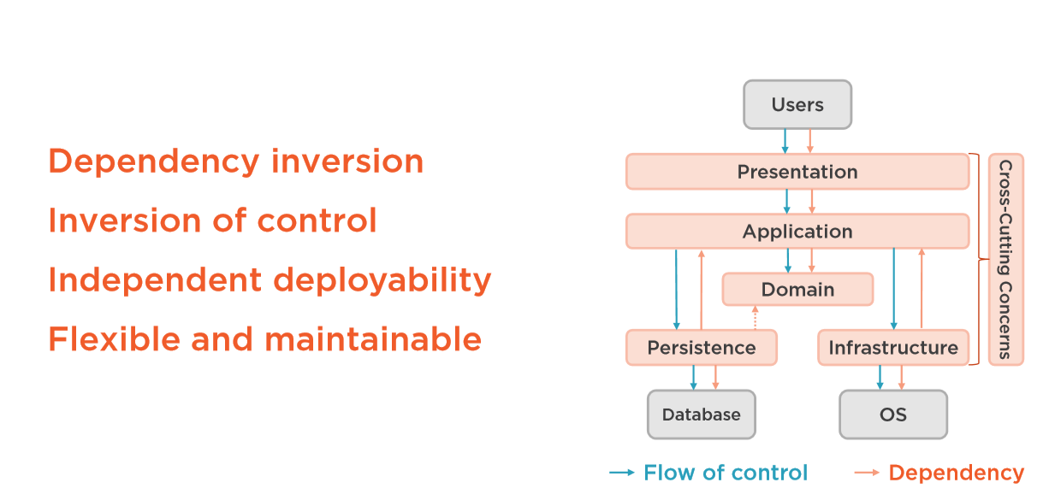
Layer dependencies

Slide 18
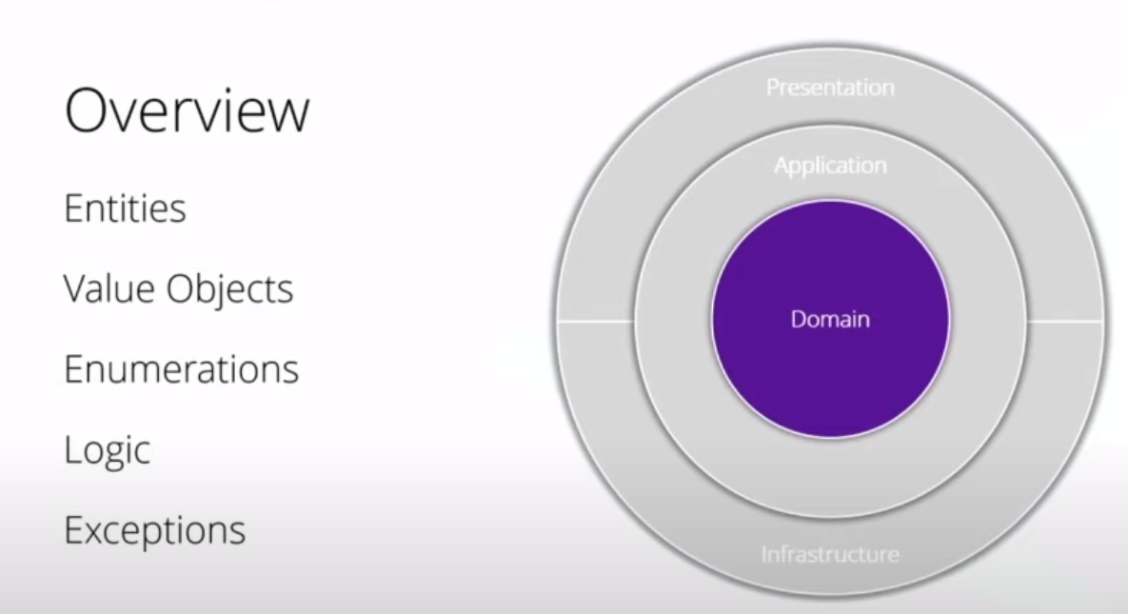

Slide 19

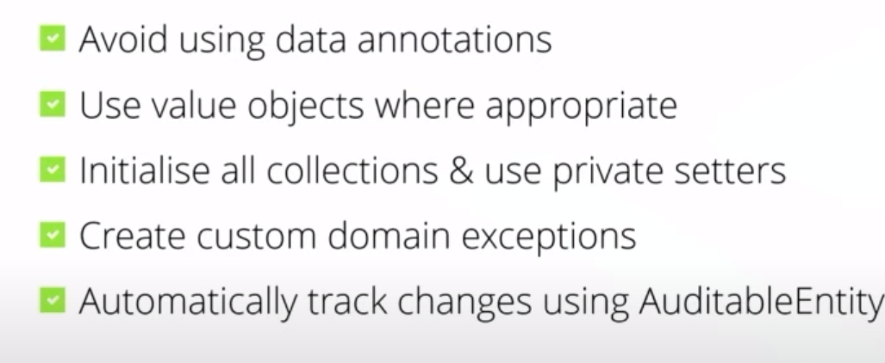
Domain Key Points

Slide 20
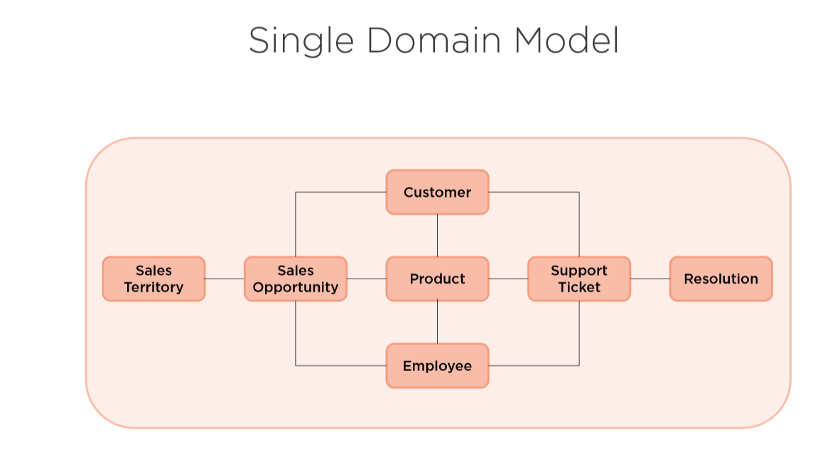

Slide 21
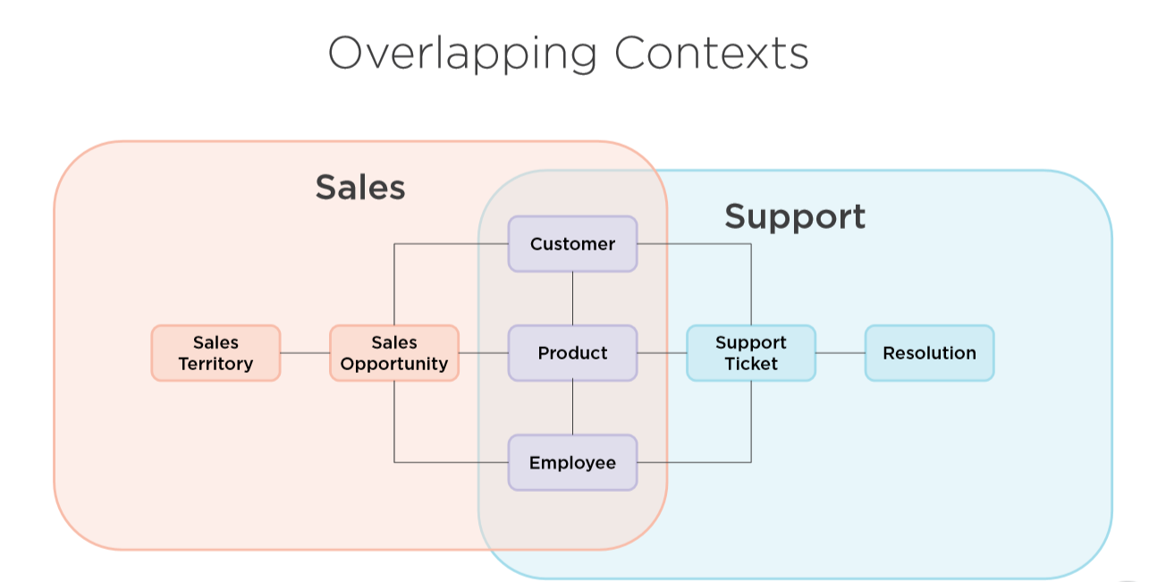

Slide 22
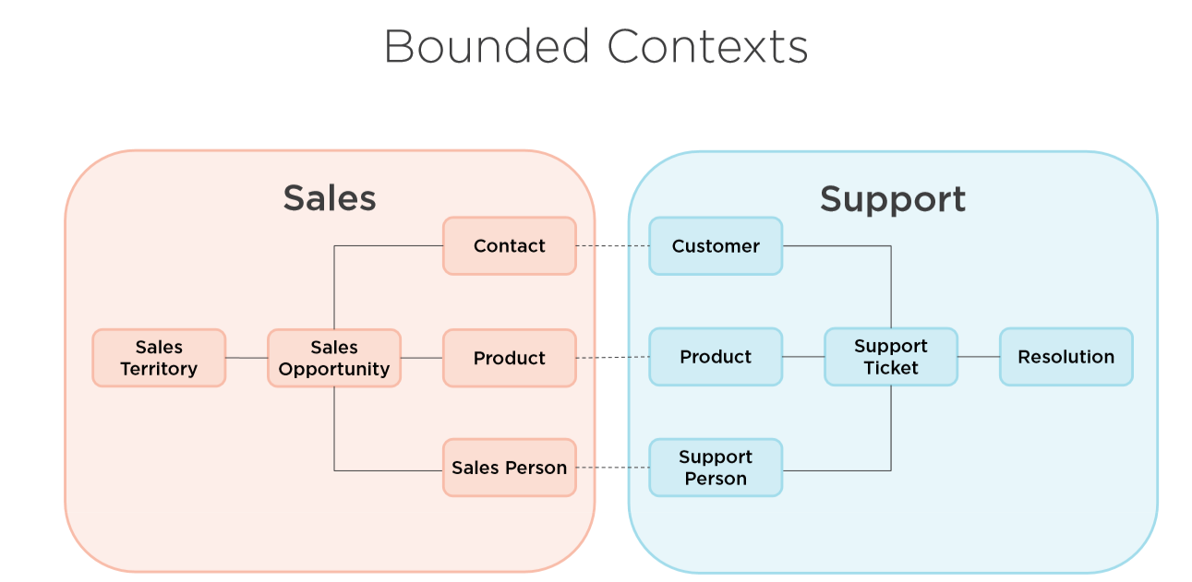

Slide 23
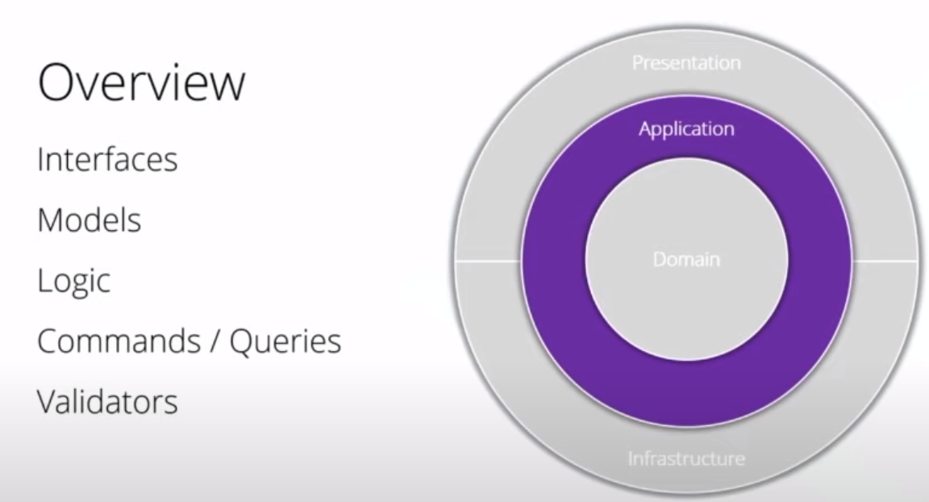

Slide 25
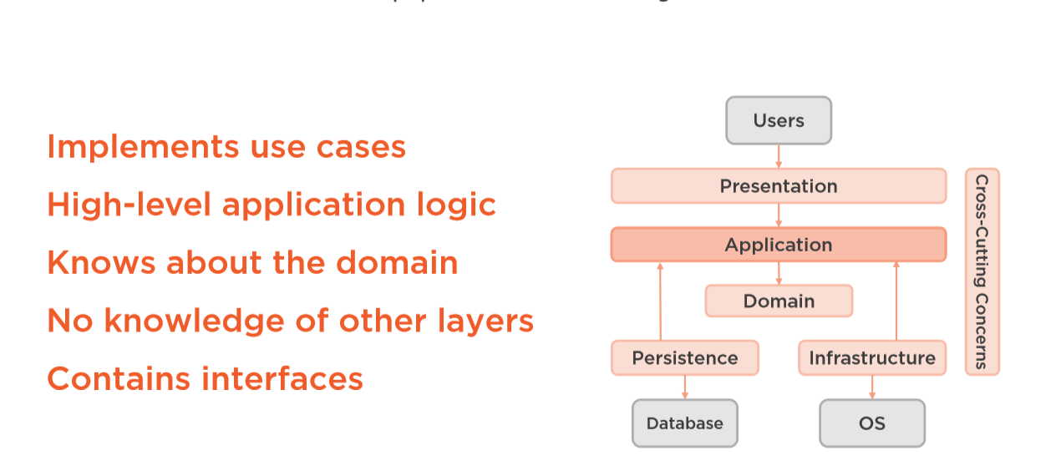
Application Layer
Notes:
Interfaces
Models
Logic
Comands/Queries
Validators

Slide 26
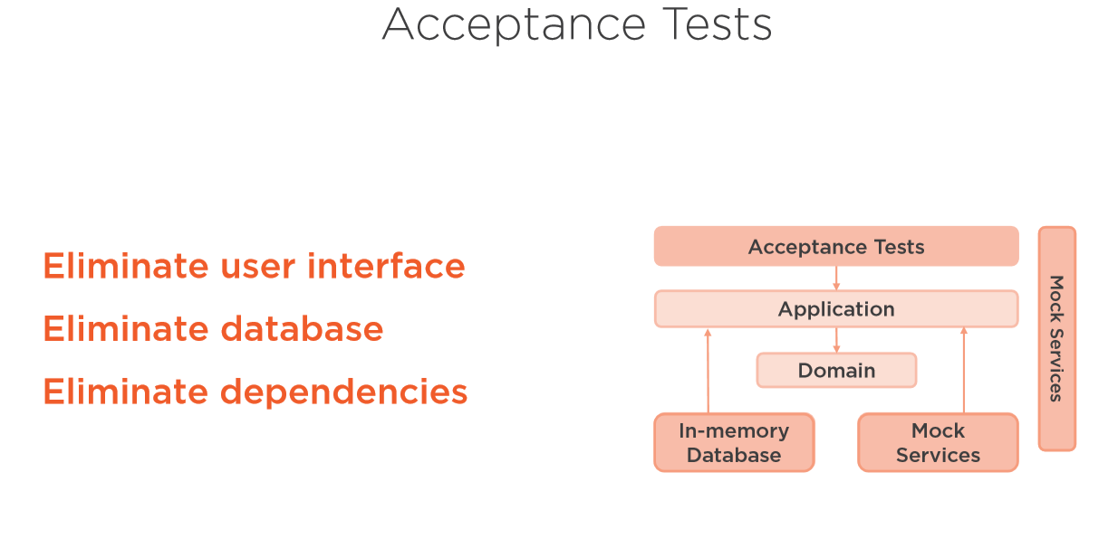

Slide 27
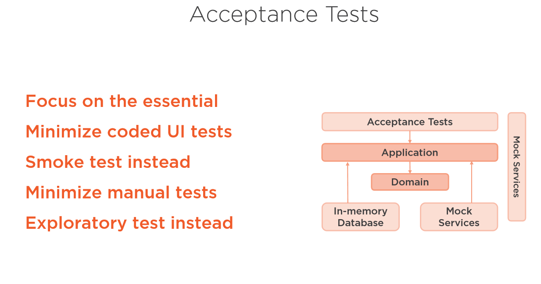

Slide 28
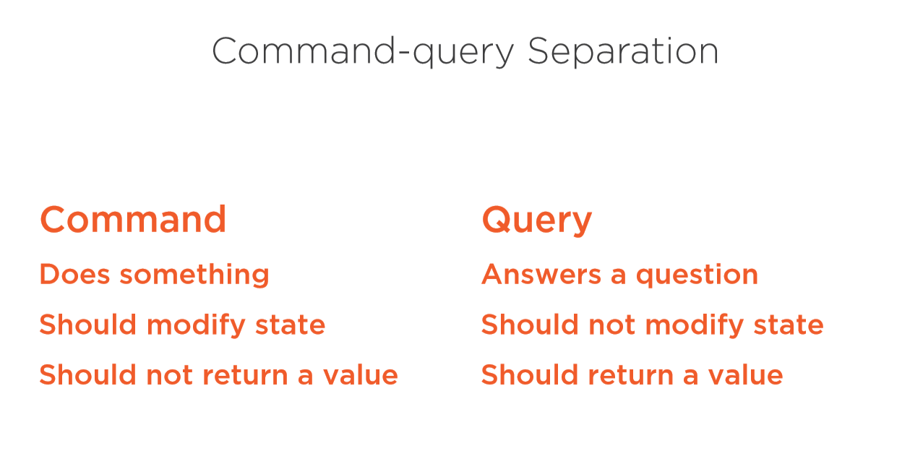

Slide 29
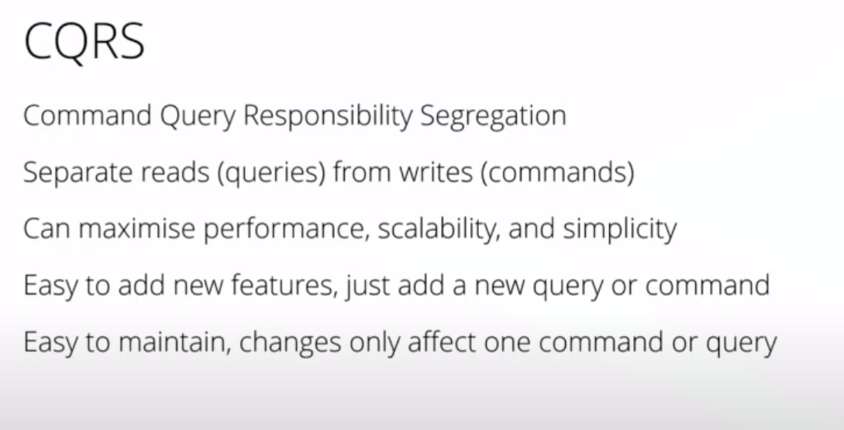

Slide 30
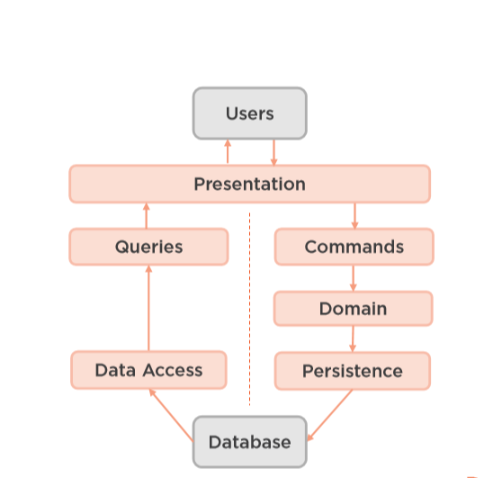
CQRS Architecture
Notes:
Jedna baza danych
Dwie bazy danych
Wiele baz danych – wiele kontekstow.
Jedne tabelki – rozne read modele

Slide 31
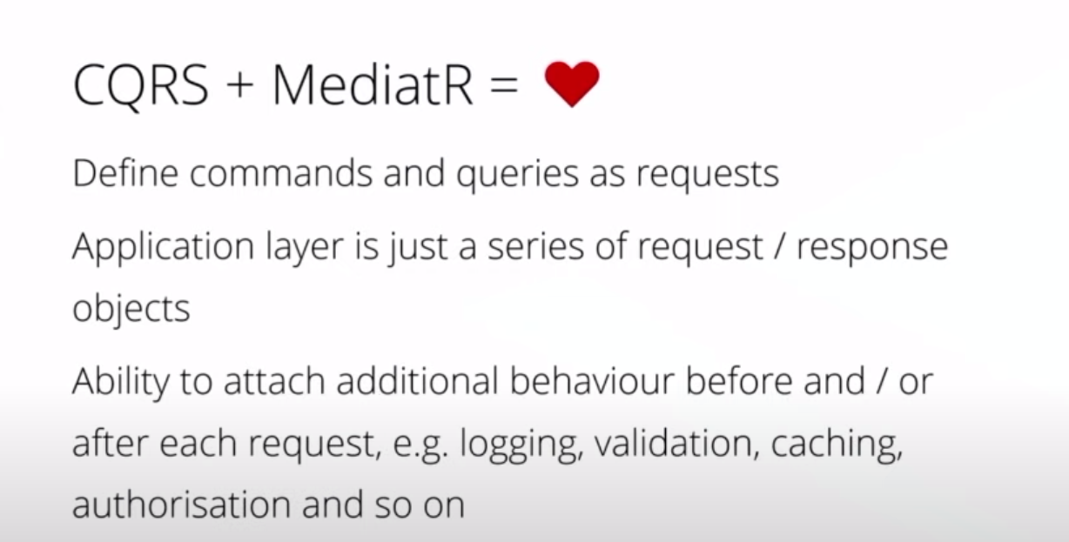

Slide 32
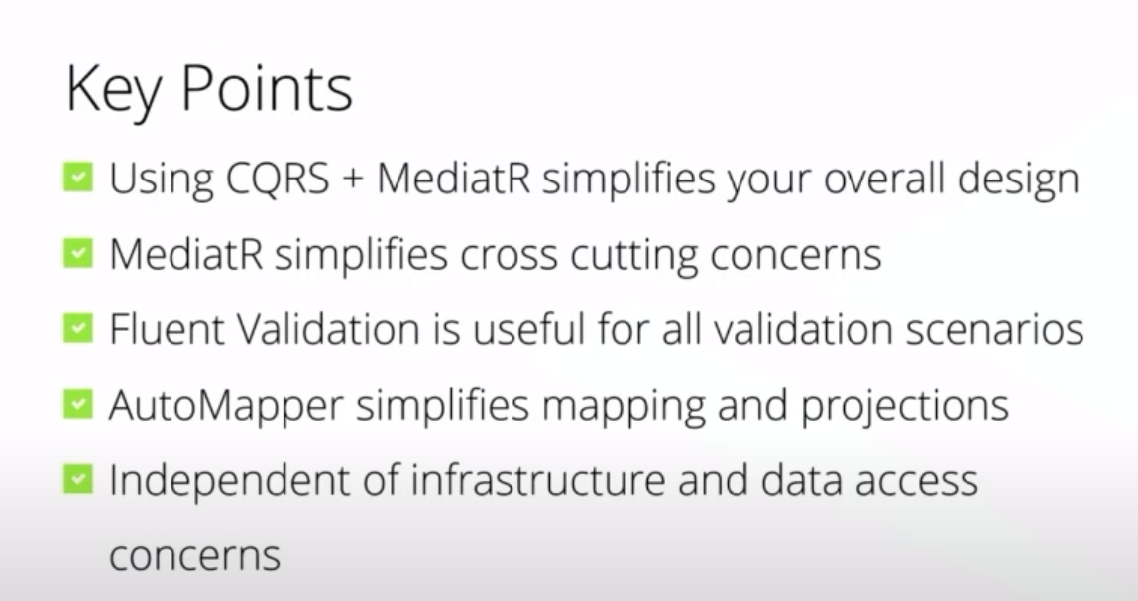

Slide 33
Radek Maziarka
https://radekmaziarka.pl/2017/08/19/cqrs-first-step-split-to-commands-and-queries/

Slide 34
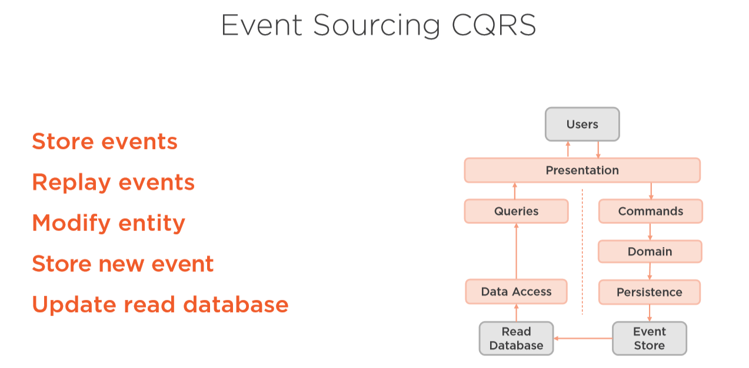
Notes:
Complete audit trail
Point in time reconstruction
Replay events
Multiple read database
Rebuild production database
Persystencja widokow

Slide 35
Oskar Dudycz
http://oskar-dudycz.pl/
https://www.szkola-event-sourcing.pl/
https://github.com/oskardudycz/EventSourcing.NetCore
DevMentors kurs w przyszłości

Slide 36
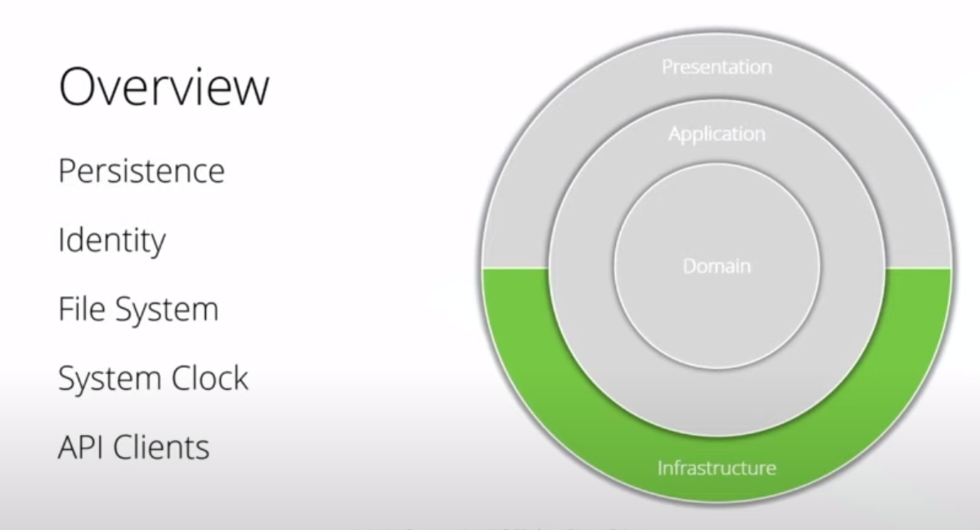
Notes:
Wszystko co zewnetrz
Może być podzielone na projekty do konkretnego zewnętrznego zrodla
Ale fajnie jak jest self containing

Slide 37
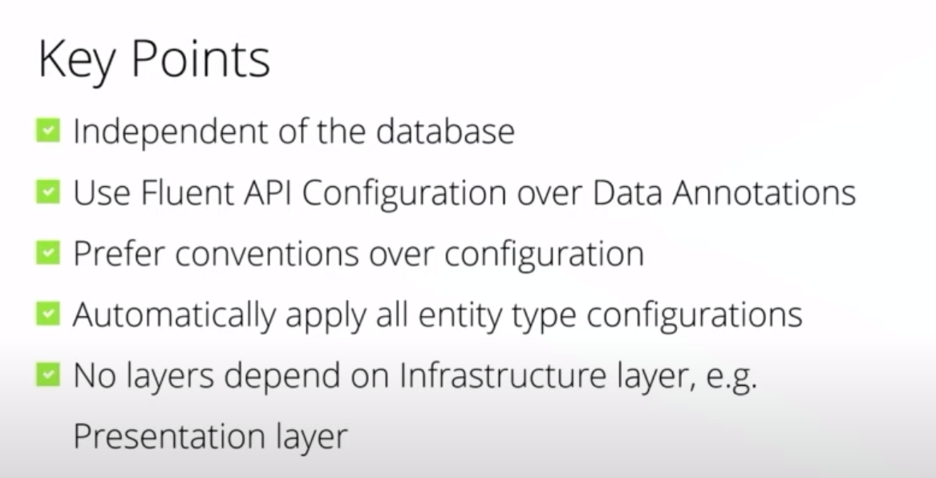

Slide 38
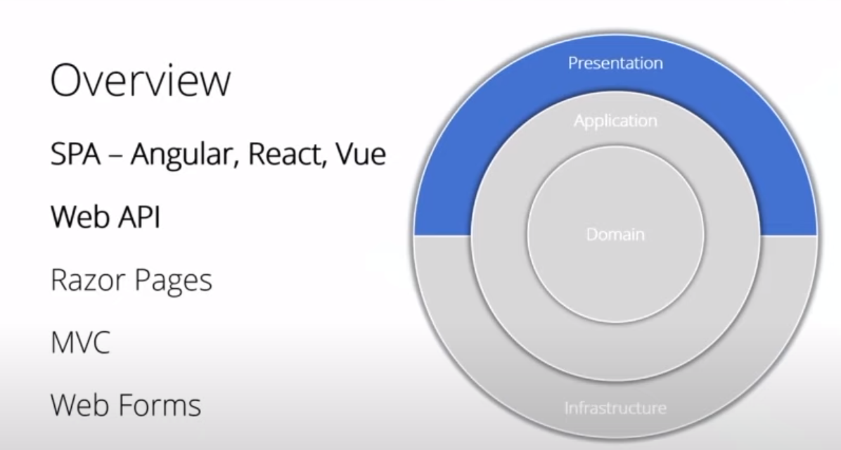

Slide 39
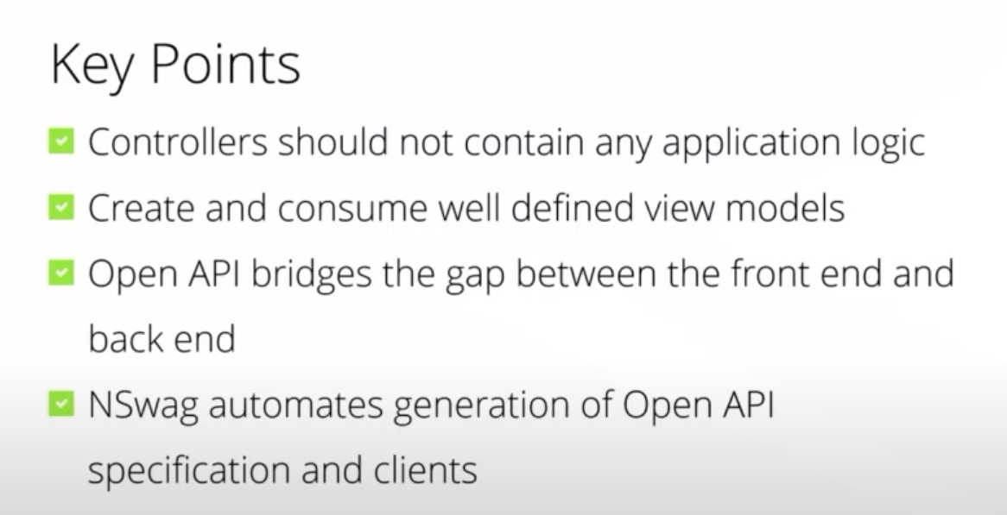

Slide 40
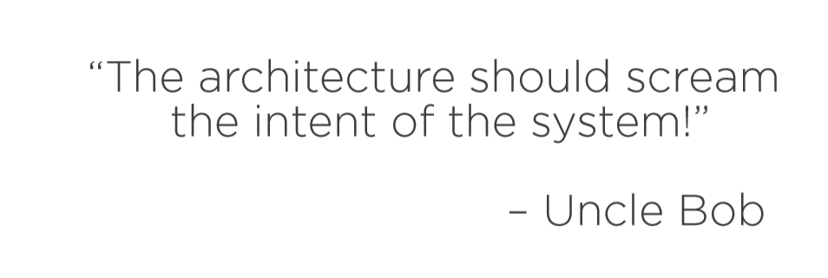
Functional Cohesion/Organization

Slide 41
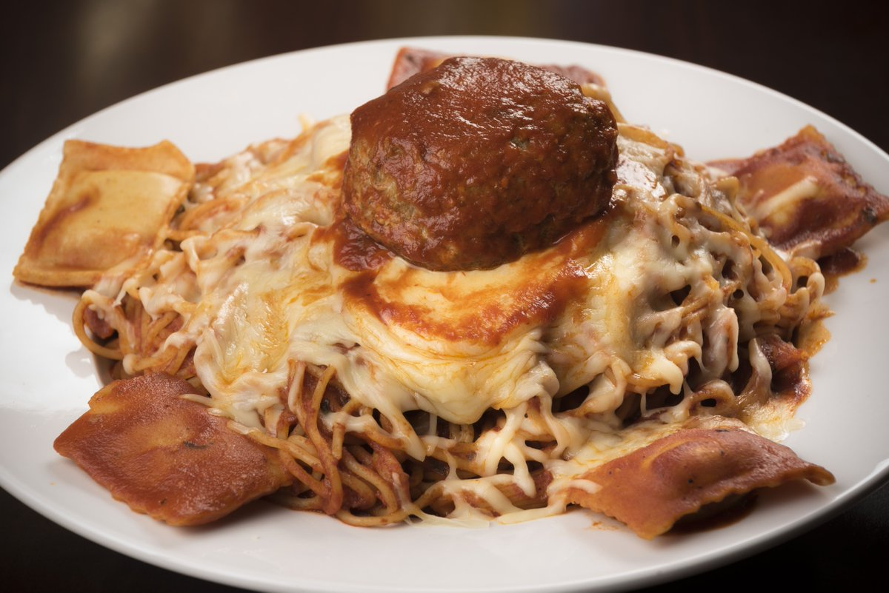
New order. Nano-services or serverless

Slide 42
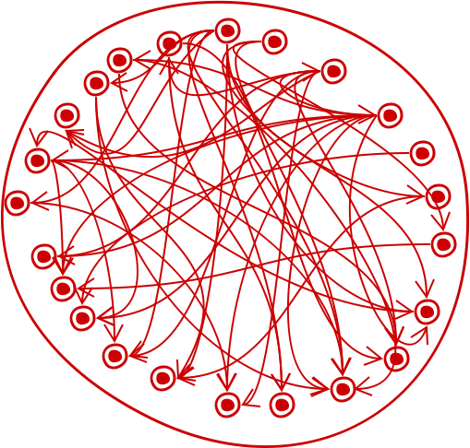
Big ball of mud

Slide 43
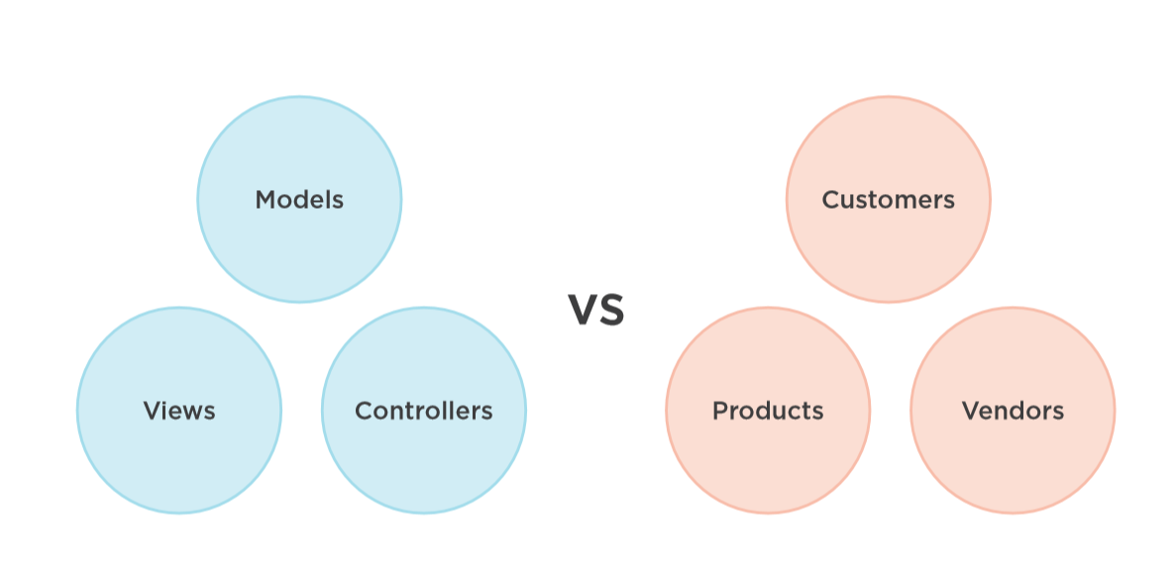

Slide 44
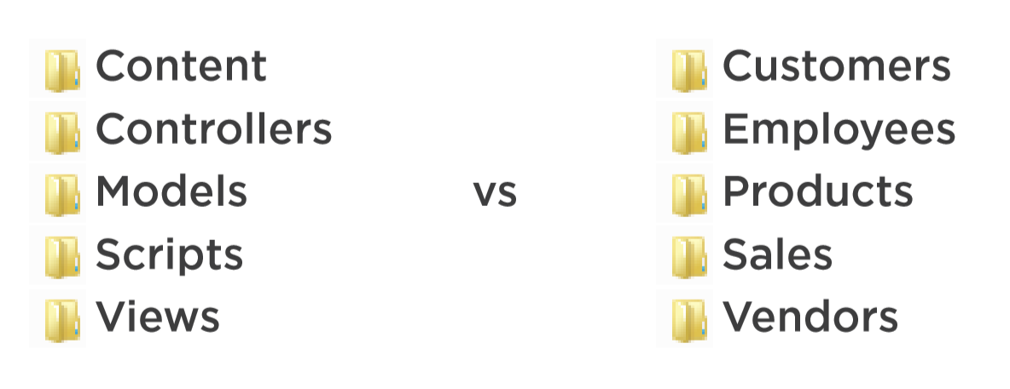

Slide 45
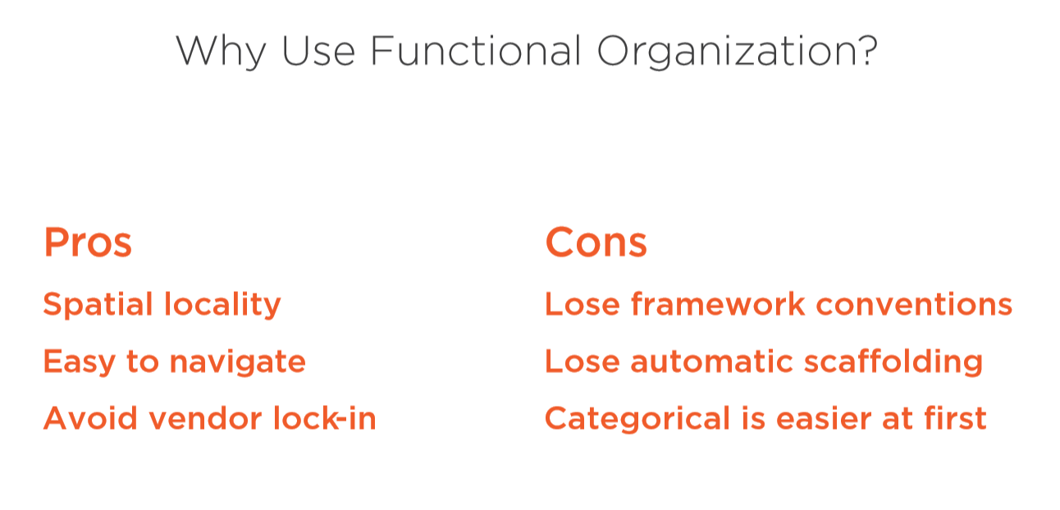

Slide 46
Modular monolith
https://www.youtube.com/watch?v=jsT2ciyaS7Q
Kamil Grzybek
https://github.com/kgrzybek/modular-monolith-with-ddd

Slide 47
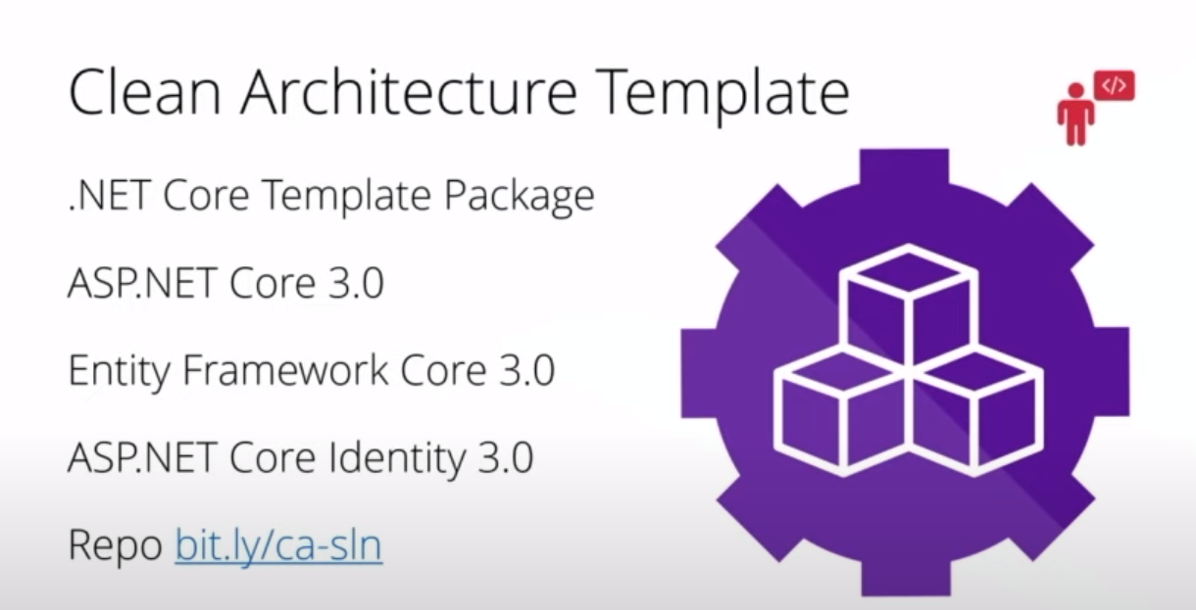

Slide 48
12 factor
Notes:
So what is .NET?

Slide 49
12 factors
I. Codebase
One codebase tracked in revision control, many deploys
II. Dependencies
Explicitly declare and isolate dependencies
III. Config
Store config in the environment
IV. Backing services
Treat backing services as attached resources
V. Build, release, run
Strictly separate build and run stages
Notes:
1. git. CaaC
2. – nugety, .net core – nie zalezmy od system. Salf-contained -> docker file
3. Konfiguracja – jedyna rzeczy rozniaca srodowiska. Przekazywanie przez zmienne srodowiskowe.
4. Bazy, kolejki, emaile, smsy -> configuration as a code
5. Publikacja – budujemy paczki deploymentowa i laczymy z konfiguracja srodowiska.
uruchomienie tutaj to release
- pamietajmy o nr releasow, wersjonowaniu
- artefakt powinien byc trwaly I niemodyfikowalny

Slide 50
12 factors
VI. Processes
Execute the app as one or more stateless processes
VII. Port binding
Export services via port binding
VIII. Concurrency
Scale out via the process model
IX. Disposability
Maximize robustness with fast startup and graceful shutdown
Crash-only architecture
Change “at most once” to “at least one” processing
Notes:
6. bezstanowo. Stan- usluga wspierajaca. Lokalny cach czy Sticky sessions – zlamanie zasady.nie zakladamy ze nasz uzytkownik podlaczy sie do danego serwera!
7. Kazda usluga ma swoj port I protocol – kazdy serwis stoi na innym porcie.
8. skalowanie. Aplikacja musi byc w stanie pracowac w oparciu o wiele procesow dzialajacych na wielu fizycznych maszynach. Wtedy kazdy process skalujemy osobno horyzontalnie. Out czyli w szerz. Bo Up mozemy tylko do jakiegos poziomu
9. zbywalnosc.kazdy process moze byc zatrzymany I zniknac. A gdy kolejnym razem bedziemy go potrzebowac to bedzie to nowy process moze nowa maszyna. COLD START. Obsluga kolejek I asynchronicznosc – kto obsluguje wiadomosc I czy skonczyl. Flush do logow
SIGTERM
-> crach –only – chaos monkey

Slide 51
12 factors
X. Dev/prod parity
Keep development, staging, and production as similar as possible
XI. Logs
Treat logs as event streams
XII. Admin processes
Run admin/management tasks as one-off processes
Notes:
10. Zmiejsz czas deployment.
Testuj I programuj na tym samym systemie, z taka sama konfiguracja z tymi samymi narzedziami
11. Logi na console + do zbiorczego miejsca Splunk, Elk, Elastik Search, application Insights
12. Automatyzacja daje procesy. Albo inaczej DEVOPS :D CI/CD as a code

Slide 52
Library
https://www.youtube.com/watch?v=5OtUm1BLmG0
https://app.pluralsight.com/library/courses/clean-architecture-patterns-practices-principles/table-of-contents
Clean Architecture with ASP.NET Core 3.0 - Jason Taylor - NDC Sydney 2019

Slide 53





Questions??
Joanna Lamch
JLamch@gmail.com
@Jlamch
https://JLamch.net https://ProgramistkaIKot.pl
THANK YOU

